Slide 1
Increase Nitin’s Savings by Cutting Unnecessary Expenses
Simple Steps to Boost Your Financial Health
Presented by: Vaishakhi Gade

Slide 2
Introduction
Objective:
Help Nitin identify and eliminate unnecessary expenses to increase his savings.
Nitin's Situation:
Job: Graphic Designer in a new company
Monthly Earnings: Rs 15,000/-
Goal: Save for a scooter for daily commute
Challenge: Unable to save for the scooter in the past couple of months
Importance:
Financial stability
Future security
Achieving financial goals

Slide 3
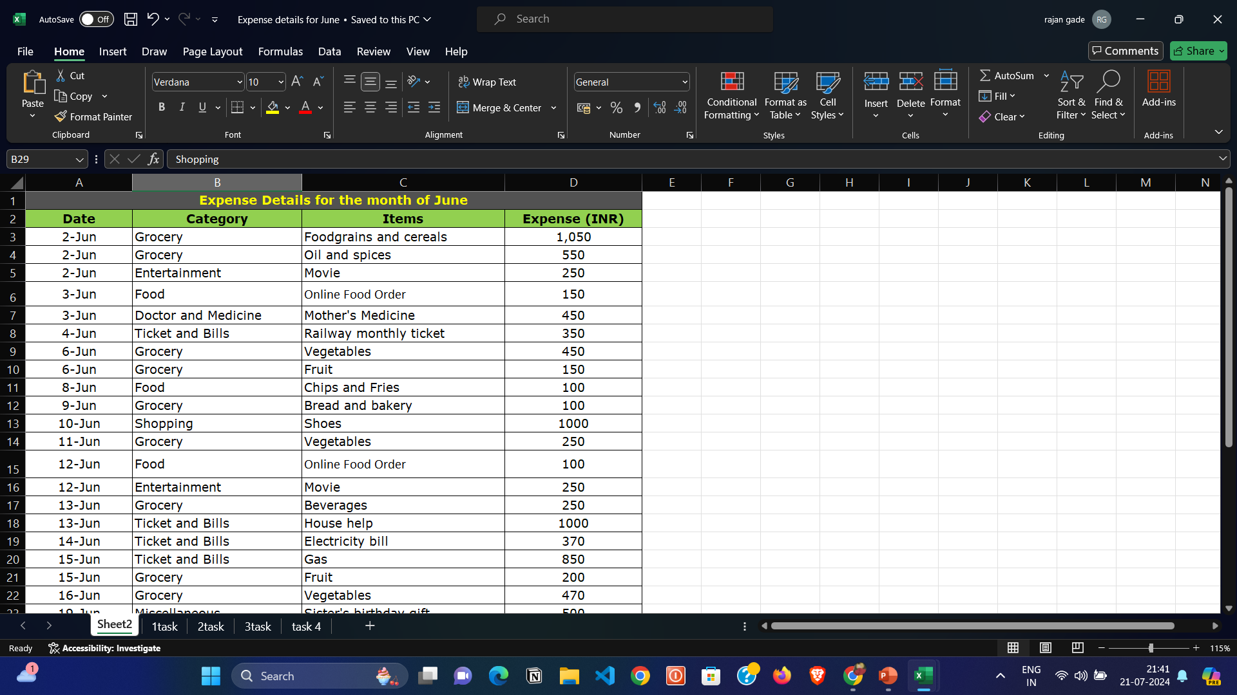
Data Analysis for June

Slide 4
How much is spent for each category ?
Row Labels | Sum of Expense (INR)
Grocery | 4690
Shopping | 3500
Ticket and Bills | 2570
Entertainment | 1000
Food | 850
Miscellaneous | 500
Doctor and Medicine | 450
Grand Total | 13560
Nitin has spent most on Grocery shopping
Along with shopping, Ticket and Bills, Entertainment being 3 highest category on which Nitin has spent on
With the following pie charge we can see the complete analysis of Nitin spendings for month June

Slide 5
How much is spent on different items of each category?
Row Labels | Sum of Expense (INR)
Doctor and Medicine | 450
Mother's Medicine | 450
Entertainment | 1000
Movie | 1000
Food | 850
Chips and Fries | 250
Online Food Order | 600
Grocery | 4690
Beverages | 250
Bread and bakery | 500
Oil and spices | 550
Fruit | 650
Foodgrains and cereals | 1050
Vegetables | 1690
Miscellaneous | 500
Sister's birthday gift | 500
Shopping | 3500
Shoes | 1000
Tshirt and Jeans | 2500
Ticket and Bills | 2570
Railway monthly ticket | 350
Electricity bill | 370
Gas | 850
House help | 1000
Grand Total | 13560

Slide 6
How many times money has been spent against different items of each category?
Row Labels | Sum of Expense (INR) | Count of Items
Doctor and Medicine | 450 | 1
Entertainment | 1000 | 4
Food | 850 | 6
Grocery | 4690 | 15
Miscellaneous | 500 | 1
Shopping | 3500 | 2
Ticket and Bills | 2570 | 4
(blank)
Grand Total | 13560 | 33
From the given pivot chart we can understand how much money Nitin has spend against each item over a month of June
Following is filter the data to display the data for Grocery items and Shopping items

Slide 7
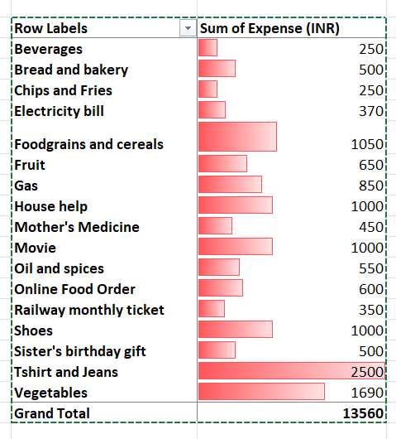
What amount is spent on each item of the categories with highest and 2nd highest expense amount
From following pivot table we can analyze on which category Nitin has spent most
Nitin has spent most on T-shirt and jeans and Vegetables

Slide 8
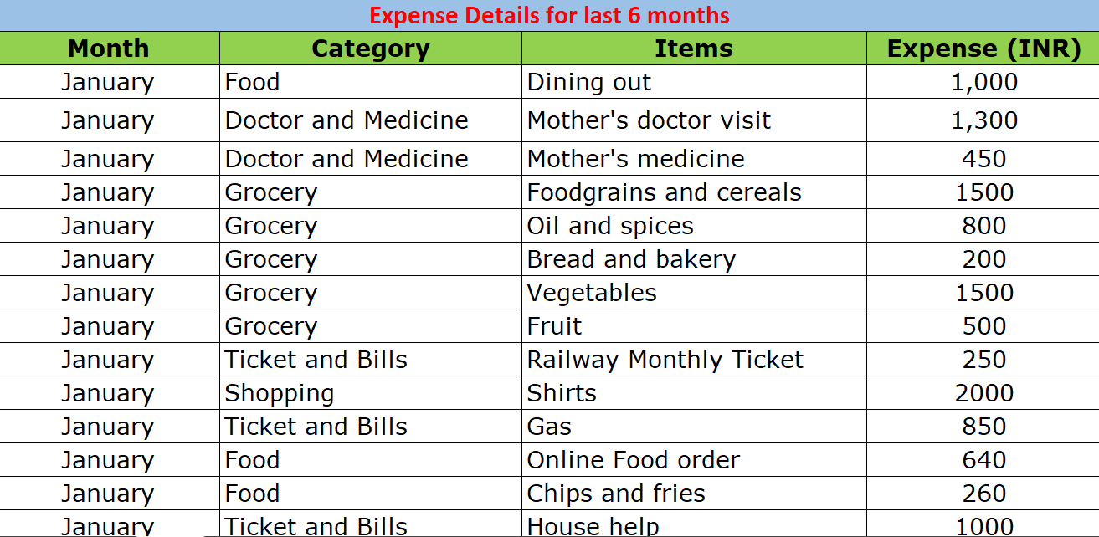
Analyzing the expense data for the last 6 months

Slide 9
Month-wise trend of expenses, Find out the month Nitin spent the most?
Row Labels | Sum of Expense (INR)
February | 15620
April | 14800
January | 13900
June | 13560
May | 13370
March | 13140
Grand Total | 84390
From the following pivot chart and pivot table we can see how much nitin has spend on things monthwise.
Nitin has spent the most in February month

Slide 10
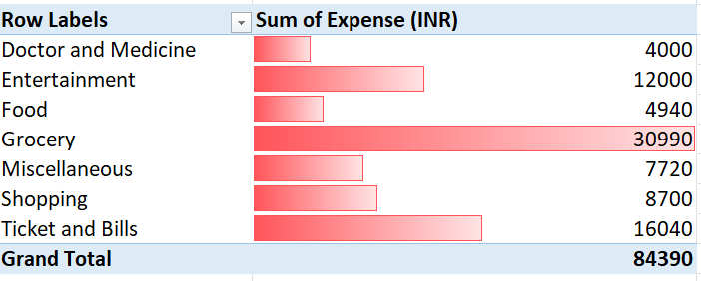
Category wise expenses
Visual representation with data bars to display categories with the highest and lowest expense amount
Nitin has spent the most on Grocery and Ticket and Bills over the six months

Slide 11
Month-wise expense of each category
Row Labels | January | February | March | April | May | June | Grand Total
Doctor and Medicine | 1750 | 450 | 450 | 450 | 450 | 450 | 4000
Entertainment | 250 | 7500 | 500 | 1250 | 1500 | 1000 | 12000
Food | 1900 |  | 800 | 1390 |  | 850 | 4940
Grocery | 4500 | 4300 | 6090 | 5460 | 5950 | 4690 | 30990
Miscellaneous | 850 | 720 | 850 | 3500 | 1300 | 500 | 7720
Shopping | 2000 |  | 1700 |  | 1500 | 3500 | 8700
Ticket and Bills | 2650 | 2650 | 2750 | 2750 | 2670 | 2570 | 16040
Grand Total | 13900 | 15620 | 13140 | 14800 | 13370 | 13560 | 84390
categories with higher expenses for each of the 6 months
Nitin has spent most on Grocery and Tickets and Bills

Slide 12
How much is spent in each month against different items of Entertainment, Food and Shopping categories?
Sum of Expense (INR) | Column Labels
Row Labels | January | February | March | April | May | June | Grand Total
Entertainment | 250 | 7500 | 500 | 1250 | 1500 | 1000 | 12000
Movie | 250 |  | 500 | 250 | 500 | 1000 | 2500
North Bengal Trip |  | 7500 |  |  |  |  | 7500
Outing with friends |  |  |  | 1000 | 1000 |  | 2000
Food | 1900 |  | 800 | 1390 |  | 850 | 4940
Chips and fries | 260 |  |  |  |  | 250 | 510
Dining out | 1000 |  | 800 | 850 |  |  | 2650
Online Food order | 640 |  |  | 540 |  | 600 | 1780
Shopping | 2000 |  | 1700 |  | 1500 | 3500 | 8700
Shirts | 2000 |  |  |  | 1500 |  | 3500
Shoes |  |  | 1700 |  |  | 1000 | 2700
Tshirt and Jeans |  |  |  |  |  | 2500 | 2500
Grand Total | 4150 | 7500 | 3000 | 2640 | 3000 | 5350 | 25640
which months have the highest amount spent for movies and dining out?
Nitin has spend the most on movies in June months
Nitin has spent the most on dining out in January month

Slide 13
Decide on the essential and less essential items and analyze the expenses
Row Labels | essential | less essential
Beverages |  | 860
Bread and bakery | 380 | 1220
Brother's tution fee | 1500
Chips and fries |  | 510
Dining out |  | 2650
Electricity bill | 2940
Foodgrains and cereals | 7660
Fruit | 3050
Gas | 5100
House help | 6000
Miscellaneous |  | 5720
Mother's doctor visit | 1300
Mother's medicine | 2700
Movie |  | 2500
North Bengal Trip |  | 7500
Oil and spices | 2990
Online Food order |  | 1780
Outing with friends |  | 2000
Railway Monthly Ticket | 2000
Shirts |  | 3500
Shoes |  | 2700
Sister's birthday gift |  | 500
Snacks |  | 5440
Tshirt and Jeans |  | 2500
Vegetables | 9390
Grand Total | 45010 | 39380
In following pivot chart we can see what are the essential and less essential things are.
We can see how much money Nitin has spent on less essential and essential things
Nitin has spent Rs 45010 on essential things whereas Rs 39380 on less essential things

Slide 14
how can Nitin increase his savings
He should stop spending on less essential items(should refer the essential and non essentials pivot chart to get better understanding)
In June month Nitin has spent the most on T-shirt and jeans items which he should avoid as it comes in less essential items
Nitin has spent the most in February month, He should make saving goals for each month and keep check on his spendings on Grocery, Shopping and Ticket and Bills category
According to the 6 months data of nitin expenses he should avoid spending over the categories such as less essential Food, Shopping and entertainment categories item i.e movie, online food, Dining out

Slide 15
how can Nitin increase his savings
Encourage Nitin to track his daily expenses. This will give him a better understanding of where his money is going and help him identify areas where he can cut back.
he can create a budget to help him control his spending. A budget will help him allocate his income towards his expenses and savings goals.
Avoid impulse purchases by not carrying around too much cash and avoiding shopping trips when bored
Review Nitin’s bills for phone, cable, and internet to see if he can get a better rate.

